Slide 1
Introduction to Operating Systems
CPSC/ECE 3220 Spring 2020
Lecture Notes
OSPP Chapter 5 – Part A
(adapted by Mark Smotherman and Lana Drachova from Tom Anderson’s slides on OSPP web site)

Slide 2
Multiple Threads with Shared Memory
Shared objects in
the data segment
and heap segment
PCB
open files, …
text
TCB1
TCB2
data
heap
T1 and T2
stack 2
stack 1

Slide 3
Lost Update / Record Out Problem
Thread A with shared “x”
x = x + 1;
// at machine code level
load r1, x
add r1, r1, #1
// switch threads →
store r1, x ←
Thread B with shared “x”
x = x + 1;
// at machine code level
load r1, x
add r1, r1, #1
store r1, x
// switch threads

Slide 4
Question: Are All Pushes Successful?
Consider shared linked list accessed as a stack: (adapted from Michael Scott)
struct node{
...
struct node *next;
}
struct node *head;
void push( struct node *new ){
new->next = head;
// what if a second push starts at this point?
head = new;
}

Slide 5
Synchronization Motivation
Thread execution is often interleaved
When threads concurrently read/write shared memory, program behavior is undefined
Two threads write to the same variable; which one should win?
Thread schedule is non-deterministic
Behavior can change when you re-run program
Compilers can reorder instructions for optimization purposes

Slide 6
Why Reordering?
Why do compilers reorder instructions?
Efficient code generation requires analyzing control/data dependency
If variables can spontaneously change, most compiler optimizations become impossible
Why do CPUs reorder instructions?
Write buffering: allow next instruction to execute while write is being completed

Slide 7
Too Much Milk Example
 | Person A | Person B
12:30 | Look in fridge. Out of milk.
12:35 | Leave for store.
12:40 | Arrive at store. | Look in fridge. Out of milk.
12:45 | Buy milk. | Leave for store.
12:50 | Arrive home, put milk away. | Arrive at store.
12:55 |  | Buy milk.
1:00 |  | Arrive home, put milk away. Oh no!

Slide 8
Definitions
Race condition: output of a concurrent program depends on the order of operations between threads
Critical section: piece of code that only one thread can execute at once
Mutual exclusion: only one thread executes a critical section at a time
Lock: prevent someone from doing something
Lock before entering critical section, before accessing shared data
Unlock when leaving, after done accessing shared data
Wait if locked (all synchronization involves waiting!)

Slide 9
Too Much Milk, Try #1
Correctness property
Someone buys if needed (liveness property)
At most one person buys (safety property)
Try #1: leave a note
if ( !milk )
if ( !note ) {
leave note
buy milk
remove note
}

Slide 10
In the program
if (milk ==0) {
if ((note == 0){
note = 1; milk ++; note = 0;
}
}
thread 1 thread2
if (milk ==0) {
if (milk ==0) {
if ((note == 0){
note = 1; milk ++; note = 0;
}
}
if ((note == 0){
note = 1; milk ++; note = 0;
}
}
Heisenbug causes the problem fail only occasionally and is almost impossible to reproduce.

Slide 11
Too Much Milk, Try #2
Thread A
leave note A
if ( !note B ) {
if ( !milk )
buy milk
}
remove note A
Thread B
leave note B
if ( !noteA ) {
if ( !milk )
buy milk
}
remove note B
Safety, but not liveness:
Both threads can check the notes, leave their own notes, and both decide not to buy milk.

Slide 12
Too Much Milk, Try #3
Thread A
leave note A
while ( note B ) // X // wait for noteB
do nothing;
if ( !milk )
buy milk;
remove note A
Thread B
leave note B
if ( !noteA ) { // Y // if no noteA
if ( !milk )
buy milk
}
remove note B
Can guarantee at X and Y that either:
Safe for me to buy
Other will buy, ok to quit
Notes:
At Y: if noNote A, safe for B to buy (means A hasn't started yet)
if note A, A is either buying, or waiting for B to quit,
so ok for B to quit
At X: if nonote B, safe to buy
if note B, don't know. A hangs around. Either:
if B buys, done
if B doesn't buy, A will.

Slide 13
Lessons
Solution is complicated
“obvious” code often has bugs
Modern compilers/architectures reorder instructions
Making reasoning even more difficult
Generalizing to many threads/processors
Even more complex: see Peterson’s algorithm

Slide 14
Peterson’s Algorithm
Peterson's algorithm (Peterson's solution) - concurrent programming algorithm that uses mutual exclusion to allow multiple threads to share the same single-use resource without conflicts using only the shared memory for interprocess communication.
Gary L. Peterson, 1981.
Complex and inefficient due to busy-waiting.
Busy-waiting or spinning - technique in which a thread repeatedly checks to see if some condition is true, for example, if a lock is available.
while (noteB==1)
;

Slide 15
Milk Solution
Use a lock!
Lock – is a primitive (synchronization variable) that only one thread at a time can use.
Provides mutual exclusion – only 1 at a time
Operations appear atomic
lock.acquire(); if (milk == 0) {
milk ++;
{
lock.release();

Slide 16
Locks
lock.acquire()
wait until lock is free, then take it (make it busy)
Lock.release()
release lock, making it free, and wake up anyone waiting for it
At most one lock holder at a time (safety)
If no one holding, gets lock (progress)
If all lock holders finish and no higher priority waiters, waiter eventually gets lock (progress)

Slide 17
Too Much Milk, #4
Locks allow concurrent code to be much simpler:
lock.acquire();
if (!milk)
buy milk
lock.release();

Slide 18
Lock Example: Malloc/Free
char *malloc (n) {
heaplock.acquire();
p = allocate memory
heaplock.release();
return p;
}
Google the implementation of __libc_malloc if you want to see the real deal.
void free(char *p) {
heaplock.acquire();
put p back on free list
heaplock.release();
}

Slide 19
Rules for Using Locks
Lock is initially free
Always acquire before accessing shared data structure
Begin of procedure!
Always release after finishing with shared data
End of procedure!
Only the lock holder can release
Never access shared data without lock
Danger!

Slide 20
Formal Properties
Mutual Exclusion - one one thread acquires the lock at one time
Progress – some thread will succeed in acquiring the lock, not necessarily in FIFO order
Bounded waiting – a waiting thread will eventually get the lock

Slide 21
Bounded Queue Case study
Bounded Queue – queue with a fixed size limit
Kernel has finite resources
Kernel uses bounded queues for IPC, TCP/UDP sockets, I/O requests
Thread-safe bounded queue – a queue safe to call from multiple concurrent threads.
Each queue has its lock and state variables (ints, floats, etc.)
MAX - number of items
Remove on empty queue returns an error
Insert on full queue returns an error

Slide 22
Example: Bounded Buffer
Initially: front = tail = 0; lock = FREE; MAX is buffer capacity
tryget() { // removing
item = NULL;
lock.acquire();
if ( front < tail ) {
item = buf[front % MAX];
front++; // ignoring ovf
}
lock.release();
return item;
}
tryput(item) { // inserting
lock.acquire();
if ( (tail – front) < size ) {
buf[tail % MAX] = item;
tail++; // ignoring ovf
}
lock.release();
}

Slide 23
Example: Bounded Buffer
For simplicity, assume no wraparound on the integers front and tail; I’ll assume you can fix that if you want
Lock at beginning of procedure; unlock at end; no access to buffer outside of locks
Note that we don’t know whether the buffer is still empty once we release the lock– we only know the state of the buffer while holding the lock!

Slide 24
Condition Variables
Allow waiting inside a critical section
Wait until queue is non-empty to remove item instead of returning an error
Called only when holding a lock
Waiting for some action to change system state
Can poll – check repeatedly
Inefficient busy-loop (busy-wait) consumes processor cycles without making useful progress, can delay scheduling of other threads
Wait: atomically release lock, suspend execution of the calling thread, relinquish processor, wait for conditional variable
Reacquire the lock when wakened by someone’s signal
Signal: wake up a waiter, if any and put on the scheduler’s READY list
Broadcast: wake up all waiters, if any

Slide 25
Condition Variable Design Pattern
methodThatWaits() {
lock.acquire();
// Read/write to shared state
while ( !testSharedState() ) {
cv.wait(&lock);
}
// Read/write shared state
lock.release();
}
methodThatSignals() {
lock.acquire();
// Read/write to shared state
// If testSharedState is now true
cv.signal(&lock);
// Read/write shared state
lock.release();
}

Slide 26
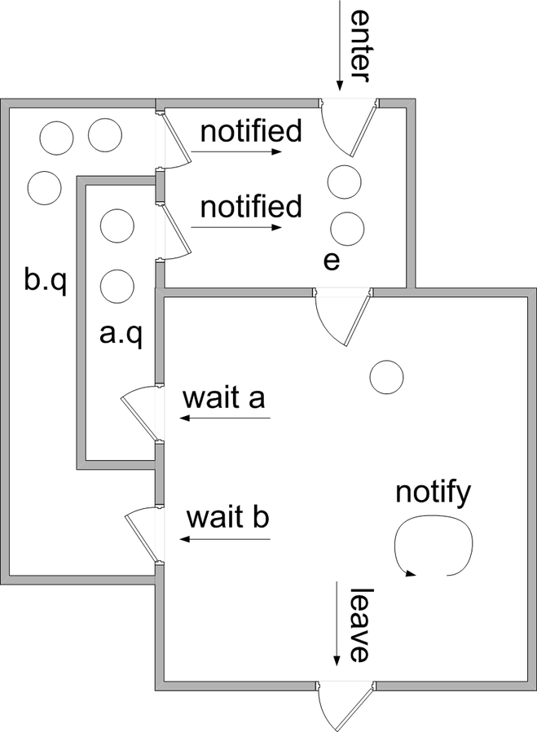
A Lock and CVs Illustrated as Rooms
acquire
class Example{
Lock lock;
CV a;
CV b;
…
void method();
}
void Example::method(){
lock.acquire();
….
// access state variables
….
lock.release();
}
signaled
signaled
lock.q
signal
release
Mesa-style monitor diagram is adapted from “Monitor_(synchronization)” Wikipedia article

Slide 27
Example: Bounded Buffer
get() {
lock.acquire();
while ( front == tail ) {
empty.wait(&lock);
}
item = buf[front % MAX];
front++; // ignoring ovf
full.signal(&lock);
lock.release();
return item;
}
put(item) {
lock.acquire();
while ( (tail – front) == MAX ) {
full.wait(&lock);
}
buf[tail % MAX] = item;
tail++; // ignoring ovf
empty.signal(&lock);
lock.release();
}
Initially: front = tail = 0; MAX is buffer capacity
empty/full are condition variables

Slide 28
Pre/Post Conditions
What is state of the bounded buffer at lock acquire?
front <= tail
front + MAX >= tail
These are also true on return from wait
And at lock release
Allows for proof of correctness

Slide 29
Pre/Post Conditions
methodThatWaits() {
lock.acquire();
// Pre-condition: State is consistent
// Read/write shared state
while ( !testSharedState() ) {
cv.wait(&lock);
}
// WARNING: shared state may
// have changed! But
// testSharedState is TRUE
// and pre-condition is true
// Read/write shared state
lock.release();
}
methodThatSignals() {
lock.acquire();
// Pre-condition: State is consistent
// Read/write shared state
// If testSharedState is now true
cv.signal(&lock);
// NO WARNING: signal keeps lock
// Read/write shared state
lock.release();
}

Slide 30
Condition Variables
ALWAYS hold lock when calling wait, signal, broadcast
Condition variable is sync FOR shared state
ALWAYS hold lock when accessing shared state
Condition variable is memoryless
If signal when no one is waiting, no op
If wait before signal, waiter wakes up
Wait atomically releases lock
What if wait, then release?
What if release, then wait?

Slide 31
Condition Variables, cont’d
When a thread is woken up from wait, it may not run immediately
Signal/broadcast puts thread on ready list
When lock is released, anyone might acquire it
Wait MUST be in a loop
while ( needToWait() ) {
condition.Wait(lock);
}
Simplifies implementation
Of condition variables and locks
Of code that uses condition variables and locks

Slide 32
Structured Synchronization
Identify objects or data structures that can be accessed by multiple threads concurrently
Add locks to object/module
Grab lock on start to every method/procedure
Release lock on finish
If need to wait
while( needToWait() ) { condition.Wait(&lock); }
Do not assume when you wake up that signaller just ran
If do something that might wake someone up
Signal or Broadcast
Always leave shared state variables in a consistent state
When lock is released, or when waiting

Slide 33
Remember the rules
Use consistent structure
Always use locks and condition variables
Always acquire lock at beginning of procedure, release at end
Always hold lock when using a condition variable
Always wait in while loop
Never spin in sleep()

Slide 34
Example: Readers and Writers
Differentiate the threads that merely read values in a shared object from those that update the values
Replace the mutual exclusion lock for a shared object with a readers/writers lock when:
there is substantial contention for the mutual exclusion lock
a substantial majority of accesses are read-only

Slide 35
Using a Readers/Writers Lock
class RWLock{
private:
// Synchronization variables
Lock lock;
CV readGo;
CV writeGo;
// State variables
int activeReaders;
int activeWriters;
int waitingReaders;
int waitingWriters;
public:
RWLock();
~RWLock() {};
void startRead();
void doneRead();
void startWrite();
void doneWrite();
private:
bool readShouldWait();
bool writeShouldWait();
};
void reader(RWLock *rwLock){
rwLock->startRead();
// read shared data
rwLock->doneRead();
}
void writer(RWLock *rwLock){
rwLock->startWrite();
// write shared data
rwLock->doneWrite();
}

Slide 36
Value of Verification
FIFOBBQ (Figure 5.14) shown to have two bugs:
The destroyed CV can be kept inside the remove queue, which will block the insert call to wake up the proper waiter
When multiple CVs are woken up within a short time and the lock-holding CV thread is not the head of removeQueue, that thread will be removed from removeQueue, return to sleep, and never wake up again
See Gu, et al., “Building Certified Concurrent OS Kernels,” CACM, Oct. 2019

Slide 37
Corrected FIFOBBQ::remove()
int FIFOBBQ::remove () {
intitem,myPostition;
CV *myCV,*nextWaiter;
lock.acquire ();
myPosition = numRemoveCalled++;
myCV = new CV;
removeQueue.append(myCV);
while (front < myPosition || front == nextEmpty) {
myCV->wait(&lock);
}
delete myCV;
item = items[front % MAX];
front ++;
nextWaiter = insertQueue.peekFront();
if (nextWaiter != NULL) nextWaiter->Signal();
// the remover now responsible for removing
// itself from the removeQueue
removeQueue.removeFromFront();
// the remover responsible for waking up the
// next in the removeQueue
nextWaiter = removeQueue.peekFront();
if (nextWaiter != NULL) nextWaiter->Signal();
lock.release();
return item;
}
From Zhong Shao at Yale, http://flint.cs.yale.edu/cs422/lectureNotes/L06.pdf

Slide 38
(if time permits)

Slide 39
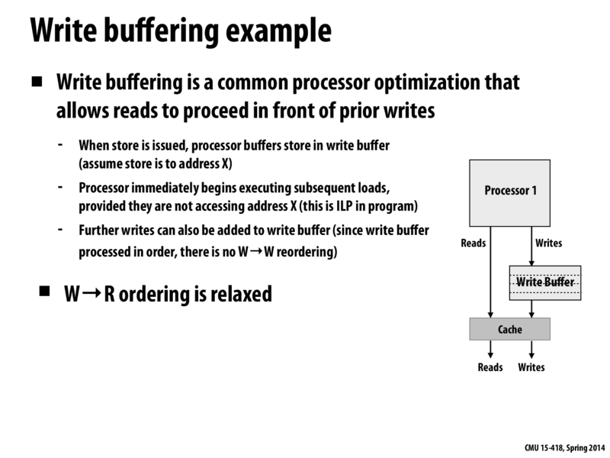
Slide from Kayvon Fatahalian, CMU, 2014

Slide 40
Memory Consistency
Rules on reordering load/stores as seen by other processors
Can hide memory write latency by allowing write buffering but need explicit drain operations (fence, memory barrier) to force ordering
Example – with read-write reordering, this code can print “0 0”
thread 1 (initially a=0 and b=0) thread 2
store a=1 store b=1
print b print a
If you place memory barriers between the store and print, the code will only be able to produce, “0 1”, “1 0”, and “1 1”
Note that Peterson's algorithm will fail under reordered references

Slide 41
Conditional Critical Regions (CCRs)
Hoare, 1972
Language structure for named critical sections, also provides for conditional waiting
Syntax
region name when ( Boolean condition ) begin statements end
or
await( Boolean condition ) region name begin statements end
Single wait queue per name, broadcast signal upon exit
Distributed Processes, 1978, and Edison, 1981

Slide 42
Monitor Influence and Development
Dijkstra, 1971
Suggested all critical sections for a shared data structure be collected into a single process, called a “secretary”
Similar to object-oriented idea
Brinch-Hansen and Hoare also start discussing the idea, calling it a “monitor”
Hoare, 1974
Multiple conditional variables, each with its own wait queue
Signal to single thread, if present, rather than broadcast
Can therefore be more efficient than CCR
Unlike semaphores, condition variables are memoryless
Signaled thread will run immediately, while signaler waits
Brinch-Hansen, 1975
Signal as last statement of procedure, suggested by Dahl

Slide 43
Monitor Implementations
Concurrent Pascal, 1975
Brinch Hansen style
Xerox Mesa programming language, 1977
Lampson, Redell, and Lauer
Nonblocking signal where signaler keeps mutex and continues
Signaled thread is merely put on ready queue

Slide 44
Monitor Implementations (2)
Modula-2+, 1984 / Modula-3, 1988
Introduced an explicit lock
POSIX threads (pthreads), 1995
ANSI/IEEE POSIX 1003.1 Runtime library
Java threads, 1995
Synchronized, wait, notify keywords
Single wait queue per synchronized object (more like CCR)
C#, 2000
Lock, wait, and pulse keywords
Many other languages

Slide 45
pthreads Approach
Uses Mesa-style relaxed scheduling for condition variable signaling
Uses Modula-style explicit mutex locks
Calls to wait name both a condition variable and a mutex
Wait releases mutex when blocked
Wait reacquires mutex when resumed
Provides broadcast signaling

Slide 46
Posix pthreads programming
#include <pthread.h> int pthread_cond_init (pthread_cond_t *cv,
const pthread_condattr_t *cattr);
initialize the condition variable pointed at by cv to its default value (cattr is NULL)
returns zero if completed successfully, or any other value if error.
multiple threads cannot simultaneously init the same conditional variable.
pthread_cond_t cv; pthread_condattr_t cattr; int ret;
/* initialize a condition variable to its default value */
ret = pthread_cond_init(&cv, NULL);
/* initialize a condition variable */ ret = pthread_cond_init(&cv, &cattr);

Slide 47
Posix pthreads programming
#include <pthread.h> continued int pthread_cond_wait (pthread_cond_t *cv, pthread_mutex_t *mutex);
atomically release the mutex pointed to by mutex and cause the calling thread to block on the conditional variable pointed to by cv.
returns zero if completed successfully, or any other value, if error.
always returns with the mutex locked and owned by the calling thread, even when returning an error.
blocked thread can be awakened by a pthread_cond_signal() or pthread_cond_broadcast().
pthread_cond_t cv; pthread_mutex_t mp; int ret;
/* wait on condition variable */
ret = pthread_cond_wait(&cv, &mp);

Slide 48
Posix pthreads programming
#include <pthread.h> int pthread_cond_wait (pthread_cond_t *cv, pthread_mutex_t *mutex);
function blocks until the condition is signaled.
It atomically releases the associated mutex lock before blocking, and atomically acquires it again before returning.
Because the condition can change before an awakened thread returns from pthread_cond_wait(), the condition that caused the wait must be retested before the mutex lock is acquired:
pthread_mutex_lock();
while(condition_is_false)
pthread_cond_wait();
pthread_mutex_unlock();

Slide 49
Posix pthreads programming
#include <pthread.h> int pthread_cond_signal (pthread_cond_t *cv);
unblock one thread that is blocked on the condition variable pointed to by cv
The scheduling policy determines the order in which blocked threads are awakened
returns zero if completed successfully, or any other value, if error.
pthread_cond_t cv; int ret;
/* one condition variable is signaled */
ret = pthread_cond_signal(&cv)

Slide 50
Posix pthreads example
pthread_mutex_t count_lock;
pthread_cond_t count_nonzero;
unsigned count;
decrement_count() {
pthread_mutex_lock(&count_lock);
while (count == 0)
pthread_cond_wait(&count_nonzero, &count_lock);
count = count - 1;
pthread_mutex_unlock(&count_lock);
}
increment_count() {
pthread_mutex_lock(&count_lock);
if (count == 0)
pthread_cond_signal(&count_nonzero);
count = count + 1;
pthread_mutex_unlock(&count_lock);
}

Slide 51
pthreads Syntax
Thread A
pthread_mutex_lock( &my_lock );
while( /* test of shared state fails */ ){
pthread_cond_wait( &my_cond_var,
&my_lock );
}
/* read/write shared state */
pthread_mutex_unlock( &my_lock );
Thread B
pthread_mutex_lock( &my_lock );
/* read/write shared state */
/* if state has changed in a way that
allows other threads to make
progress, then signal or broadcast */
pthread_cond_signal( &my_cond_var );
pthread_mutex_unlock( &my_lock );

Slide 52
Posix Producer/Consumer
Finite-size buffer and two classes of threads, one puts items into the buffer (producers) and another takes items out of the buffer (consumers).
Producer must wait until the buffer has space before it can put something in.
Consumer must wait until something is in the buffer before it can take something out.
A condition variable represents a queue of threads waiting for some condition to be signaled.
two queues, one (less) for producers waiting for a slot in the buffer, and the other (more) for consumers waiting for a buffer slot containing information.
mutex - data structure describing the buffer that must be accessed by only one thread at a time.

Slide 53
Posix Producer/Consumer
typedef struct {
char buf[BSIZE];
int occupied;
int nextin;
int nextout;
pthread_mutex_t mutex;
pthread_cond_t more; // consumers
pthread_cond_t less; // producers
}
buffer_t; buffer_t buffer;

Slide 54
Posix Producer
void producer(buffer_t *b, char item) {
pthread_mutex_lock(&b->mutex);
while (b->occupied >= BSIZE)
pthread_cond_wait(&b->less, &b->mutex);
assert(b->occupied < BSIZE);
b->buf[b->nextin++] = item;
b->nextin %= BSIZE;
b->occupied++;
/* now: either b->occupied < BSIZE and b->nextin is the index of the next
empty slot in the buffer, or b->occupied == BSIZE and b->nextin is the index
of the next (occupied) slot that will be emptied by a consumer
(such as b->nextin == b->nextout) */
pthread_cond_signal(&b->more);
pthread_mutex_unlock(&b->mutex);
}

Slide 55
Posix Producer
Acquires the mutex protecting the buffer data structure
Makes certain that space is available for the item being produced
If not, it calls pthread_cond_wait() and joins the queue of threads waiting for the condition less, representing there is room in the buffer, to be signaled.
As part of the call to pthread_cond_wait(), the thread releases its lock on the mutex
The waiting producer threads depend on consumer threads to signal when the condition is true
When the condition is signaled, the first thread waiting on less is awakened. However, before the thread can return from pthread_cond_wait(), it must acquire the lock on the mutex again. This ensures that it again has mutually exclusive access to the buffer data structure.
The thread then must check that there really is room available in the buffer; if so, it puts its item into the next available slot.
At the same time, consumer threads might be waiting for items to appear in the buffer.
These threads are waiting on the condition variable more.
A producer thread, having just deposited something in the buffer, calls pthread_cond_signal() to wake up the next waiting consumer. (If there are no waiting consumers, this call has no effect.)
Finally, the producer thread unlocks the mutex, allowing other threads to operate on the buffer data structure.

Slide 56
Posix Consumer
char consumer(buffer_t *b) {
char item;
pthread_mutex_lock(&b->mutex);
while(b->occupied <= 0)
pthread_cond_wait(&b->more, &b->mutex);
assert(b->occupied > 0);
item = b->buf[b->nextout++];
b->nextout %= BSIZE;
b->occupied--;
/* now: either b->occupied > 0 and b->nextout is the index of the next
occupied slot in the buffer, or b->occupied == 0 and b->nextout is the
index of the next (empty) slot that will be filled by a producer
(such as b->nextout == b->nextin) */
pthread_cond_signal(&b->less);
pthread_mutex_unlock(&b->mutex); return(item); }

Slide 57
More resources on threads and condition variables
http://home.deib.polimi.it/loiacono/uploads/Teaching/CP/CP_04_Pthread_CondVar.pdf
http://pages.cs.wisc.edu/~remzi/OSTEP/threads-cv.pdf

Slide 58
Mesa vs. Hoare semantics
Mesa
Signal puts waiter on ready list
Signaller keeps lock and processor
Hoare
Signal gives processor and lock to waiter
When waiter finishes, processor/lock given back to signaller
Nested signals possible!

